Slide 1

SmartStay24
Luca, Markus, Paul, Sebastian

Slide 2
01
Algorithm

Slide 3
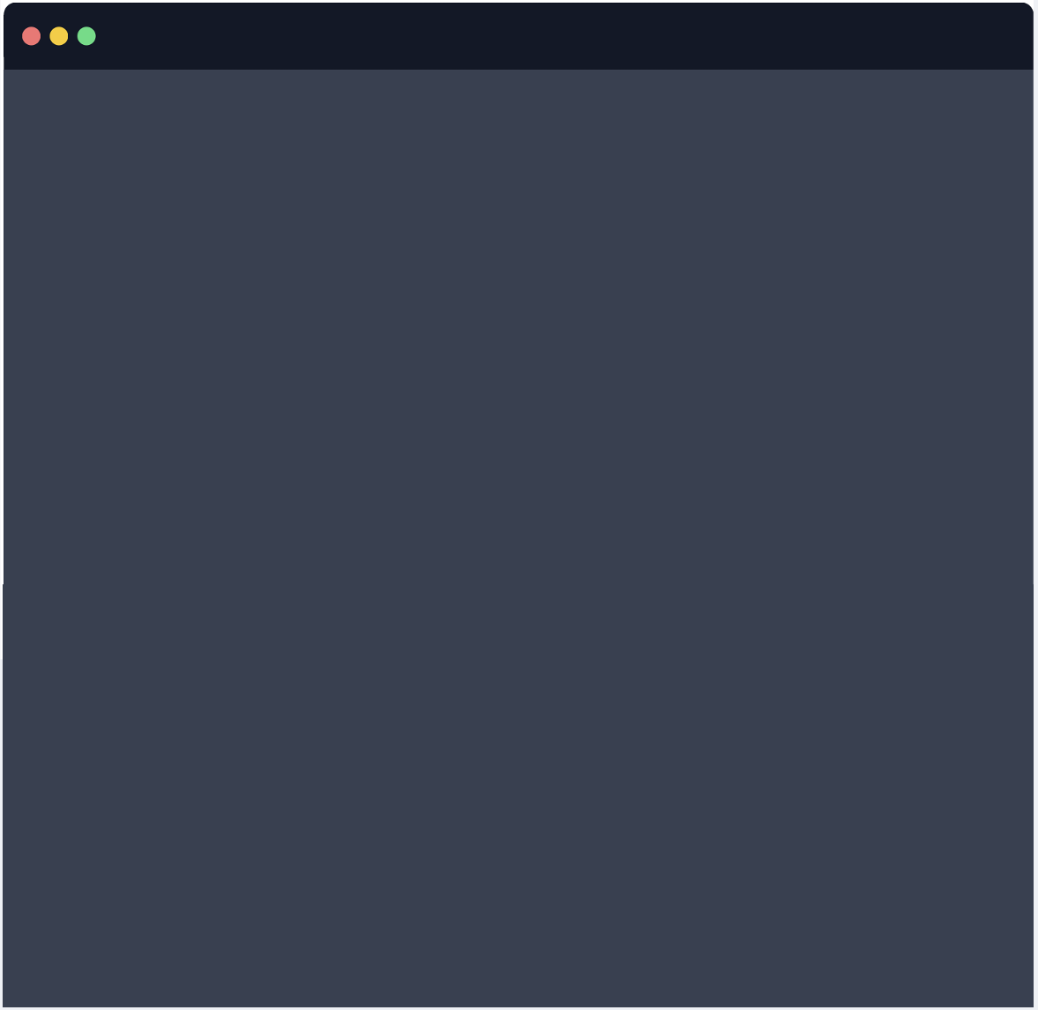
Algorithm
Parse
Filter
Sort
The natural
language commands
into structured data
Filter hotels that
don‘t meet hard
requirements from
the client
Based on the
remaining soft
requirements
{
"status": "success",
"features": {
"pool": { "value": "=1", "importance": 10 },
"sauna": { "value": "=1", "importance": 10 },
"breakfast": { "value": "=1", "importance": 7 },
"gym": { "value": "=1", "importance": 3 }
}
}

Slide 4
Parse
Natural Language Structured Data (JSON)
{
"status": "success",
"features": {
"pool": { "value": "=1", "importance": 10 },
"sauna": { "value": "=1", "importance": 10 },
"breakfast": { "value": "=1", "importance": 7 },
"gym": { "value": "=1", "importance": 3 }
}
}
„I want a Hotel with a pool and a sauna.
Having breakfast would be nice and maybe a gym.“

Slide 5
Filter
hard requirements
Requirement | Value
Pool | 1
Beach | 1
… | 1
Name | Pool | Beach
Hotel 1 | 1 | 0
Hotel 2 | 1 | 1
Hotel 3 | 0 | 0

Slide 6
Filter
out hard requirements
Requirement | Value
Pool | 1
Beach | 1
… | 1
Name | Pool | Beach
Hotel 1 | 1 | 0
Hotel 2 | 1 | 1
Hotel 3 | 0 | 0

Slide 7
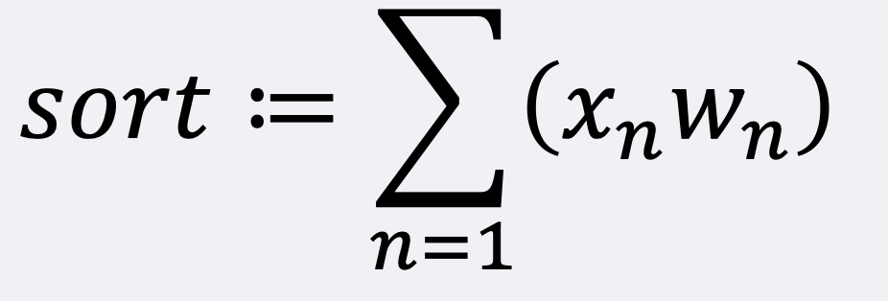
Sort
Based on soft Requirements
Requirement | Value | Weight
Breakfast | 1 | 7
Gym | 1 | 3
Name | Breakfast | Gym
Hotel 2 | 0 | 1
Hotel 4 | 1 | 1
Hotel 5 | 1 | 0

Slide 8
Sort
Based on soft Requirements
Requirement | Value | Weight
Breakfast | 1 | 7
Gym | 1 | 3
Name | Breakfast | Gym
Hotel 2 | 0 | 1
Hotel 4 | 1 | 1
Hotel 5 | 1 | 0

Slide 9
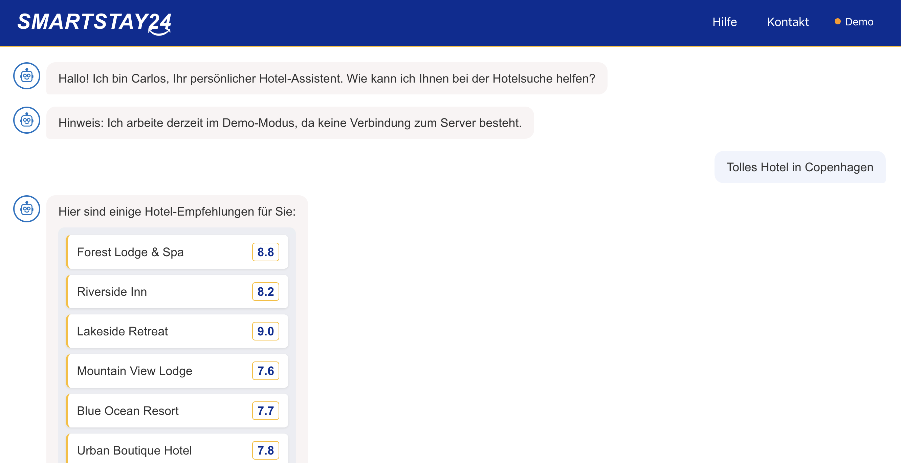

02
Demo

Slide 10
02
Demo

Slide 11


Thanks!
https://smart-stay24.de/
Please keep this slide for attribution
Thank you for your attention!

